Slide 1
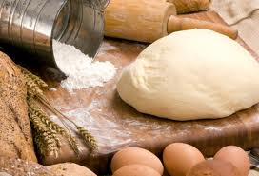
Yeast Breads

Slide 2
Yeast Breads in General
They have a distinctively appealing ____________smell and delicious taste that cannot be matched to commercially prepared sandwich breads.
Many meal managers rely on the ease of bread ____________________to make homemade bread an option to their menu plans.

Slide 3
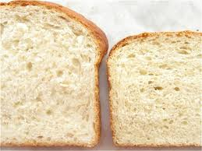
Making Yeast Breads
Involves several steps
Basic ingredients:

Slide 4
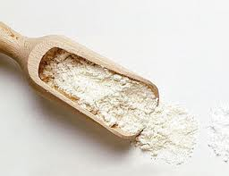
Flour
Gives ________________________________bread because of protein called _____________________
Various types of flour contain different amounts of gluten
:gives good results for most products
:highest gluten content & gives bread strong structure
: contains less gluten & gives cakes a tender structure
:relatively low-protein flour (aka low gluten) that is often called for in making biscuits, cookies, pie crusts, and pastries.

Slide 5
Liquid
Water or milk are usually used
Purpose:
Milk adds nutrients and helps keep the bread fresher longer

Slide 6
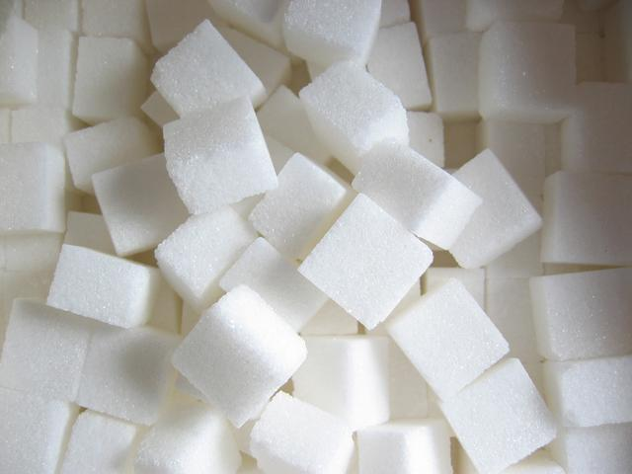
Fat and Sugar
Fat:
Tenderizer because it traps _________ and causes the dough layers to separate
Sugar:
Provides extra ______________for yeast so dough rises faster
Too much _______________ makes yeast work more slowly
Helps bread _________________
Adds _____________________________to dough

Slide 7
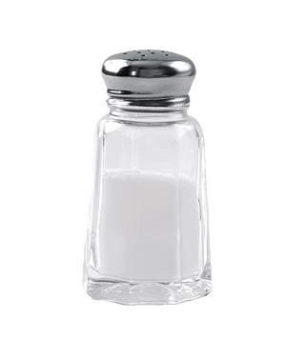
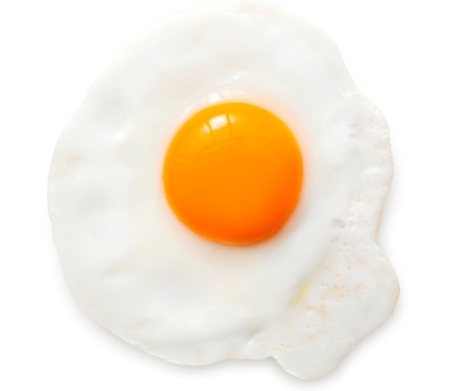
Eggs and Salt
Eggs:
When beaten, incorporate ___________
Add flavor, color, & strength because of protein content
Salt:
Without salt, dough ________________ and hard to handle, also leaves small holes on bottom & outside of product
Regulates _____________________

Slide 8
Different types of yeast
Fresh or cake yeast-yeast cells compressed into blocks (30% yeast/70% moisture)
Kept ___________________________________________
Remains viable for a couple weeks
Active dry yeast-stuff in little triple pouches
Instant yeast-available in pouches, jars, and 1 lb bags
Sometimes marketed as “rapid rise” yeast
Can be added ____________________to ingredients, no activation required.

Slide 9
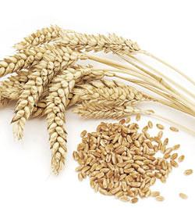
Gluten
High protein made from _______________________
__________________dough develops gluten
Smooth, silky, and an elastic ball
Review: Kneading = pressing the dough with the heels of your hands, fold it and turn it.

Slide 10
Fermentation/Proofing
________________________: enzymes in yeast produce alcohols & CO2 by breaking down carbohydrates
As gas __________________ the bread it pushes around protein & water molecules, enabling them to form more _________________
__________________________: Activating yeast before adding it to the dry ingredients by mixing it with warm water and a pinch of sugar.
___________________________: allowing bread to rise in fridge
Most CO2 is produced during the rising process at room temp. between 80-85 degrees F

Slide 11
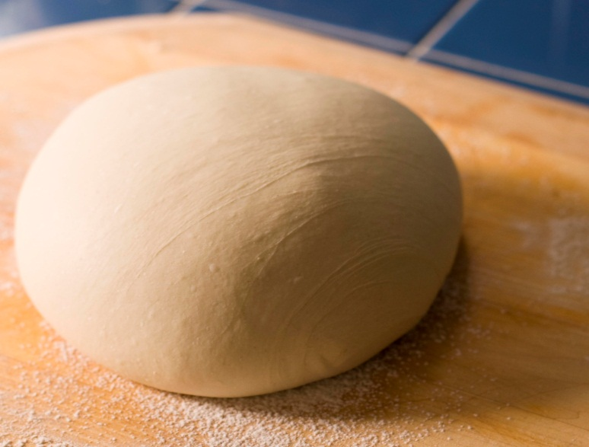
Punching down dough
Excess gas escapes which makes it ____________________________________!
How do you know when to punch down dough?

Slide 12
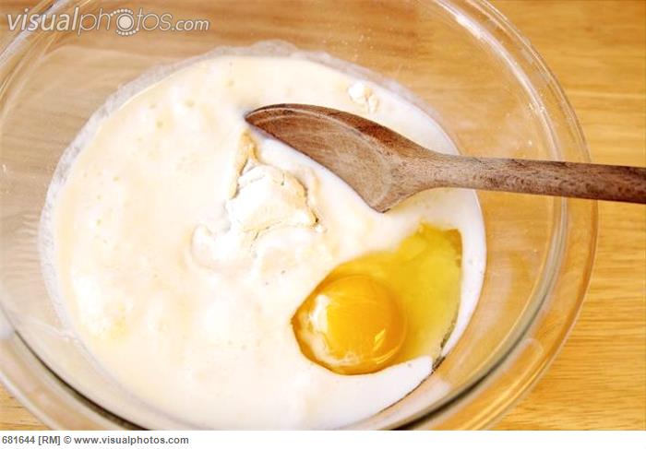
2 types of mixing methods

Slide 13
Conventional Method
Dissolve yeast in water (________________ degrees F.) and let stand for ___________ minutes
Water too cold= growth won’t take place
Water too hot= yeast is killed
Heat the _____________________________, to melt the fat.
Cool the liquid to about ________degrees F. while still warm, add the dissolved yeast
Add the flour and mix according to the recipe

Slide 14
Mixer Method
Use only __________________________________
Combine __________________________with part of the flour, sugar, and salt
Heat fat and liquid between ____________ degrees F.
Add liquid to dry ingredients and beat until well blended
Higher temp. needed because there are more ingredients to be warmed so that yeast growth can be activated
Add the remaining flour and continue mixing according to the recipe.

Slide 15
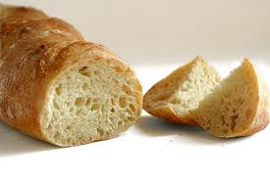
Characteristics of Yeast Breads
A high quality loaf of yeast bread has a large volume and a smooth, rounded top.
If the yeast dough had been under- or over- worked, the finished product will have a _________________________. (This is because the carbon dioxide leaked out)

Slide 16
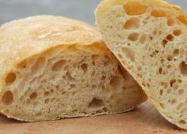
Characteristics of Yeast Breads
If you allow bread to rise for too long before baking, the top of the loaf may be over expanding (mushroom top looking).
If you do not allow bread to rise long enough before baking, it will have large _________________ on the sides of the loaf.

Slide 17
Time Saving Techniques
_____________ Dough -mix, knead and then freeze until ready for baking.
Bread Machines -machine designed to make bread easily, but they are not full-proof.
_____________________Dough- dough is designed to rise slowly in the refrigerator and is kneaded.
_______________ Dough -dough is designed to rise slowly in the refrigerator and uses the batter method.

Slide 18
“Isn’t Bread Fattening?”
Answer:
Bread provides mostly ___________________carbohydrates, which supply 2 calories per gram, or about _________ calories for the average slice. If you’re worried about calories, go easy on high-fat spreads, such as butter and margarine.

