Slide 1
Nutrition & Special Diets

Slide 2
What are nutrients?
Six categories
of nutrients

Slide 3
Carbohydrates
Simple Carbohydrates
Foods with LOTS of sugar: oranges, milk, cookies, candy
Notes:
-Made up of carbon, hydrogen, and oxygen
-2 different types we are going to talk about
-simple
-complex
-45-65% of a persons daily caloric intake should be from carbohydrates
-foods rich in complex carbs are better than simple carbs.

Slide 4
Complex Carbohydrates
Starches that are composed of many sugars __________________________________
They provide the body _______________________________________since they are digested more slowly than sugars.
Foods with LOTS of starch:
Notes:
-Found in many plant foods such as potatoes
-grains-rice, cereals, and wheat
-when you eat complex carbohydrates your body (digests) breaks the starch into simple sugars that can be absorbed into your bloodstream. That’s why its slower to digest.
-FIBER
-is a complex carbohydrate but is not considered a nutrient because its not broken down and absorbed into your bloodstream.
-still necessary for the proper functioning of your digestive system.
-helps prevent constipation
-may reduce risk of colon cancer
-may help prevent heart disease

Slide 5
Protein
Structure: Proteins are made from many ____________________________ connected together in different arrangements.
Function: Provide the _______________________________your body needs to grow and repair itself
Complete proteins:
Foods containing:
Examples: fish, meat, eggs, milk, cheese
Notes:
-High protein foods
-meats, eggs, poultry, milk and milk products
-Nuts, dried beans, dried peas, and lentils contain a lot of protein also.
-10-35% of diet needs to be protein

Slide 6
Incomplete proteins
Examples: Legumes, nuts, whole grains
Fat
Functions:
_________________________ source for the body
(more than _____________ and _______________)
Help protect and cushion vital organs as well as joints

Slide 7
Fat
Structure:
Fats belong to a group of organic compounds called lipids which are substances that
________________________________________________________.
Fatty acids are the ___________________________of fats.
Unsaturated fats:
Contain fatty acids that are missing hydrogen atoms
At room temperature, they are typically in _________________ form.
Foods with a lot of unsaturated fat:

Slide 8
Saturated fats:
Contain fatty acids with the MAXIMUM amount of hydrogen atoms
At room temperature, they are typically
__________________________________________________.
Diets with ________________________________saturated fat
have been known to cause ____________________________
Foods with a lot of saturated fat:
Notes:
-ANIMAL FATS
-lard and dairy products
-too much can lead to heart disease
-TRANS FAT
-when manufacturers add hydrogen to the fat molecules in vegetables oils.
-foods that contain these stay fresher longer

Slide 9
Calories
What is a calorie?
The ____________________obtained from carbohydrates, proteins, and fats is ____________________in units called calories.

Slide 10
Do you know the
MOST IMPORTANT nutrient is?
Function
Assists with the transport of materials in the body by making up most of the ___________________of blood (plasma)
Helps regulate body temperature, and helps break down food in the ___________________________
Food sources: vegetables, fruit, milk

Slide 11
Micronutrients
Minerals and vitamins are called micronutrients since they
are needed by your body in _____________________ amounts.
The minerals and most of the vitamins your body needs must be obtained from the FOODS you eat since your
body cannot __________________________.
Micronutrients: Minerals
Minerals are ________________________substances that are required by your body in order to develop and grow properly.
Some Important Minerals:

Slide 12
Calcium
Function: Helps build strong bones and teeth, regulates __________________________clotting
Food sources: dairy products, leafy and green vegetables
Iron
Function: Helps build hemoglobin which is the __________________________________of your red blood cells
Food sources: eggs, meats, whole grains
Notes:
Helps with functioning of your nervous system.
Good sources of Calcium-Dairy products of course but some people cannot digest dairy products so what can they eat to get Ca?
-Beet greens, collard greens, broccoli, and tofu
A lack of Ca can lead to osteoporosis-bones gradually weaken usually a disease of older people but what you do now can affect what happens as you get older.
85% of girls do not get enough Ca in their diet.

Slide 13
Potassium
Function: Helps regulate ___________________________in the body, assists with the normal functioning of muscles and nerves
Food sources:
Micronutrients: Vitamins
Vitamins: Group of ___________________________________that help your body maintain normal metabolism, growth, and development
Two Groups of Vitamins:
Notes:
Potassium and Sodium work together to maintain water balance in the body
People who consume enough potassium each day generally have lower blood pressure than people who do not
Foods rich in potassium:
baked potatoes, spinach, bananas, dried fruits, oranges, soybeans, tomato products, milk, and carrots.

Slide 14
Water-Soluble Vitamins:
Vitamins that dissolve in water and are NOT
__________________________________________________________
Vitamin _____ and Vitamin _____
Fat-Soluble Vitamins:
Vitamins that dissolve into and are transported by fat
They can be stored in:
Vitamins A, D, E, and K
Notes:
Not stored in the body for future use.
Must eat foods with these vitamins everyday

Slide 15
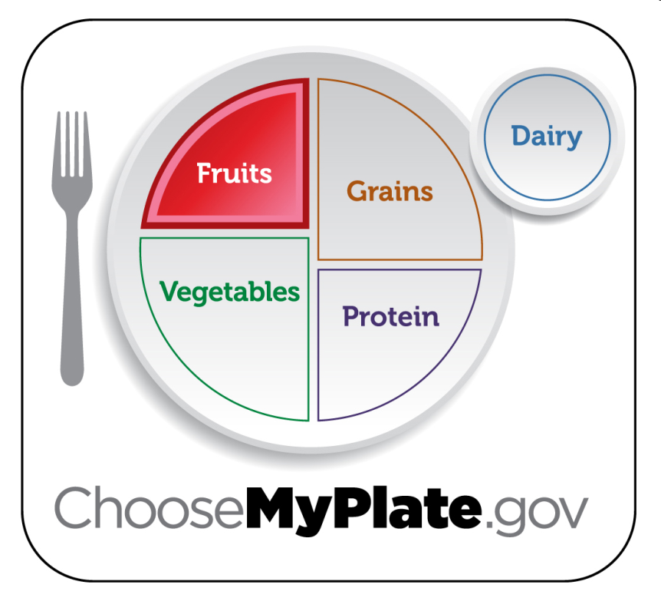
Fruits Group
Use fruits as snacks, salads or desserts.
Choose whole or cut up fruits more often than fruit juice.
Key Consumer Message:
Boys 9-13 | 1 ½ c. daily
Boys 14-18 | 2 c. daily
Girls 9-18 | 1 ½ c. daily
Notes:
Any fruit or 100% fruit juice counts as part of the fruit group. Fruits may be fresh, canned, frozen or dried. They may be whole, cut up or pureed.
*The serving amounts indicated on the chart above are appropriate for individuals who get less than 30 minutes per day of moderate physical exercise beyond normal daily activities. Those who are more physically active may be able to consumer more while staying within calorie needs.

Slide 16
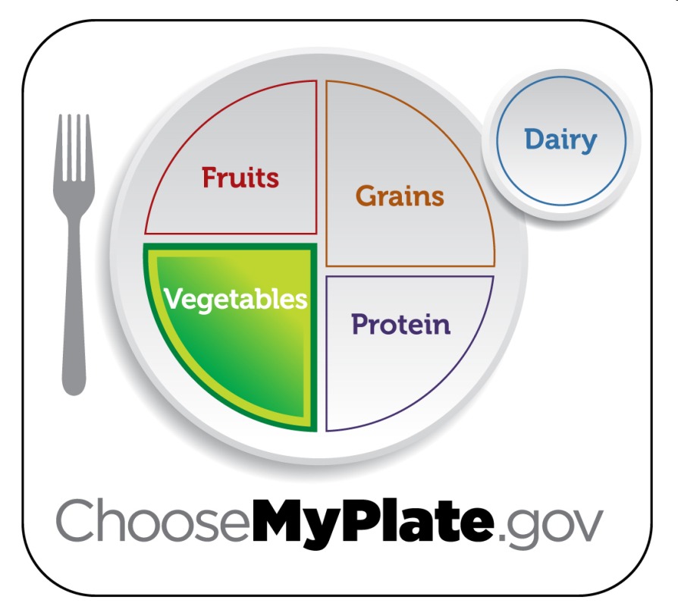
Vegetables Group
Choose fresh, frozen, canned or dried.
Eat red, orange and dark green vegetables.
Key Consumer Message:
Boys 9-13 | 2 ½ c. daily
Boys 14-18 | 3 c. daily
Girls 9-13 | 2 c. daily
Girls 14-18 | 2 ½ c. daily
Notes:
Any vegetable or 100% vegetable juice counts as a member of the vegetable group. Vegetables may be raw or cooked, fresh, frozen, canned or dried/dehydrated. They may be whole, cut up or mashed.
Vegetables are organized into five sub-groups based on their nutrient content:
Dark Green Vegetables: broccoli, dark green leafy lettuce, spinach
Red and Orange Vegetables: squash, carrots, pumpkin, tomatoes, red peppers, sweet potatoes
Beans and Peas: black beans, pinto beans, kidney beans, soy beans, lentil beans, split peas
Starchy Vegetables: corn, green peas, lima beans, potatoes
Other Vegetables: artichokes, asparagus, avocados, beets, Brussels sprouts, cabbage, cauliflower, celery, cucumbers, eggplant, green beans, peppers, iceberg lettuce, mushrooms, onions, zucchini
*The serving amounts indicated on the chart above are appropriate for individuals who get less than 30 minutes per day of moderate physical exercise beyond normal daily activities. Those who are more physically active may be able to consumer more while staying within calorie needs.

Slide 17
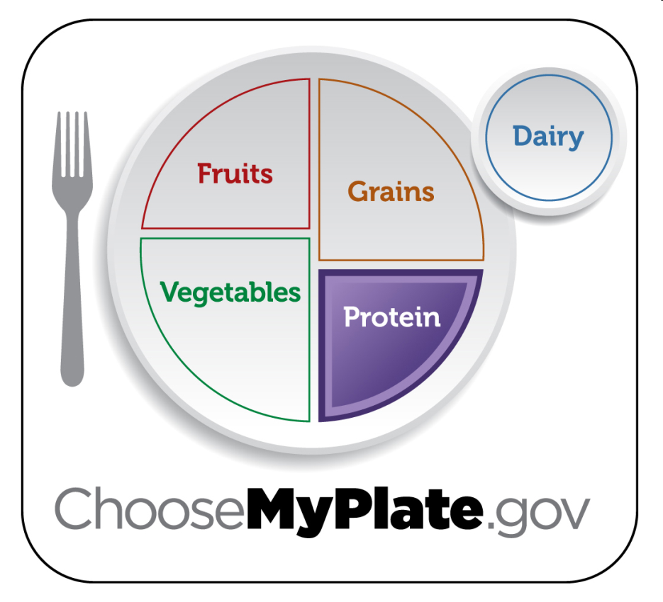
Protein Group
Choose a variety of different protein sources.
In place of some meat and poultry, choose 8 oz. seafood per week.
Try grilling, broiling, poaching or roasting.
Key Consumer Message:
Boys 9-13 | 5 oz. daily
Boys 14-18 | 6 ½ oz. daily
Girls 9-18 | 5 oz. daily
Notes:
All foods made from meat, poultry, seafood, beans and peas, eggs, processed soy products, nuts and seeds are considered part of the protein food group. Beans and peas are also part of the vegetable group.
Select a variety of protein foods to improve nutrient intake and health benefits, including at least 8 oz. of cooked seafood per week.
Examples:
Meats: lean cuts of beef, ham, pork or veal
Eggs
Beans and Peas
Processed Soy Products: tofu, veggie burgers, TVP (Textured Vegetable Protein)
Poultry: chicken, duck, goose, turkey
Nuts and Seeds: almonds, cashews, peanuts, sesame seeds, walnuts
Seafood: catfish, cod, flounder, halibut, salmon, tuna, trout
Shellfish and Canned Fish: clams, crabs, lobsters, shrimp, calamari, anchovies, sardines
*The serving amounts indicated on the chart above are appropriate for individuals who get less than 30 minutes per day of moderate physical exercise beyond normal daily activities. Those who are more physically active may be able to consumer more while staying within calorie needs.
*The serving amounts indicated on the chart above are appropriate for individuals who get less than 30 minutes per day of moderate physical exercise beyond normal daily activities. Those who are more physically active may be able to consumer more while staying within calorie needs.

Slide 18
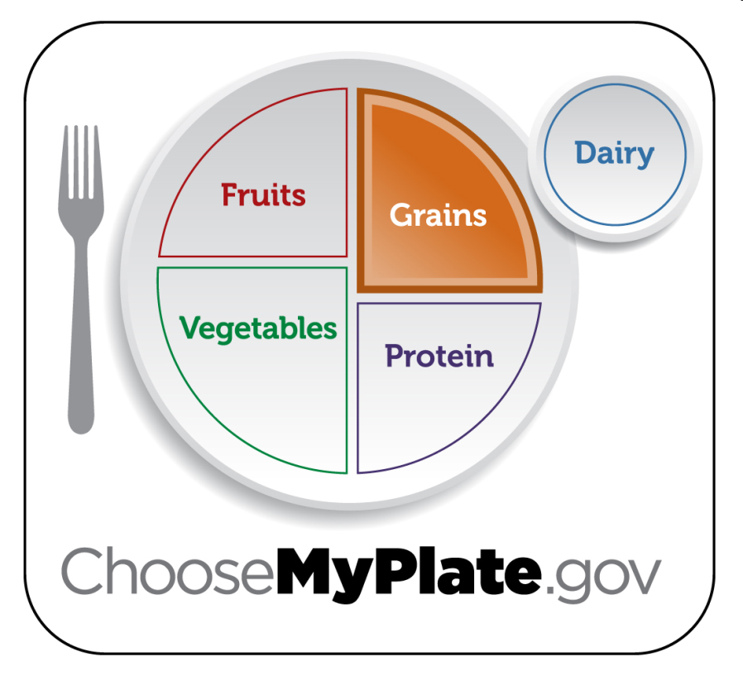
Grains Group
Choose 100% whole grain cereals, breads, crackers, rice and pasta.
2. Check the ingredients list on food packages to find whole grain foods.
Key Consumer Message:
 | Grains | Whole Grains
Boys 9-13 | 6 oz. daily | 3 oz. daily
Boys 14-18 | 8 oz. daily | 4 oz. daily
Girls 9-13 | 5 oz. daily | 2.5 oz. daily
Girls 14-18 | 6 oz. daily | 3 oz. daily
Notes:
Grains are divided into two subgroups:
Whole Grains: contain the entire grain kernel (bran, germ and endosperm)
Examples: whole wheat flour, cracked wheat, oatmeal, brown rice
Refined Grains: have been milled (a process that removes the bran and germ). This is done to give grains a finer texture and improve their shelf life, but it also removes dietary fiber, iron and many B-Vitamins.
Examples: white flour, white rice, spaghetti, pretzels, crackers, breakfast cereals
*Note: Most refined grains are enriched. This means certain B-Vitamins and Iron are added back in after processing.
*The serving amounts indicated on the chart above are appropriate for individuals who get less than 30 minutes per day of moderate physical exercise beyond normal daily activities. Those who are more physically active may be able to consumer more while staying within calorie needs.

Slide 19
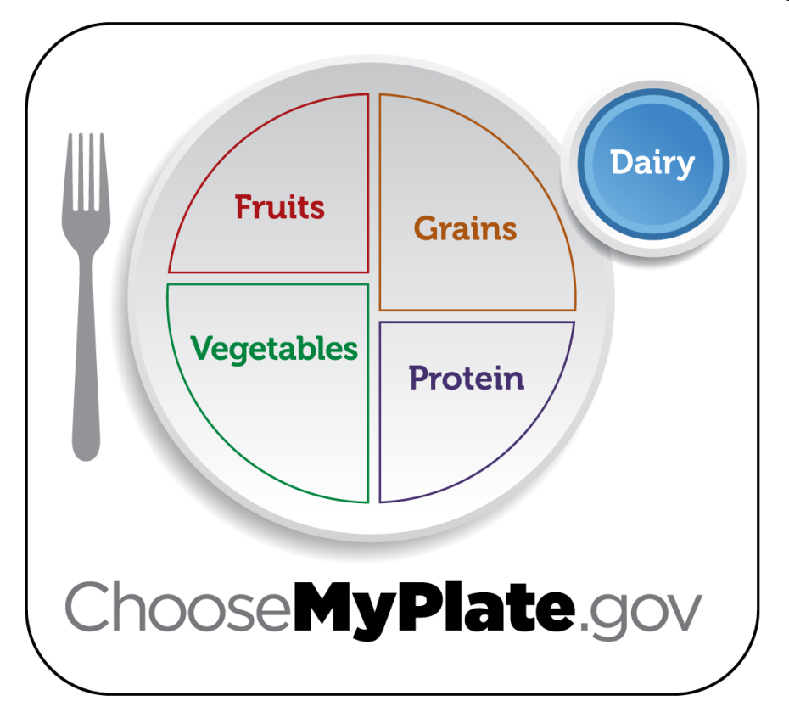
Dairy Group
Low-fat or fat-free dairy products have the same amount of calcium and other essential nutrients as whole milk, but less fat and calories.
Key Consumer Message:
Boys 9-18 | 3 c. daily
Girls 9-18 | 3 c. daily
Notes:
All fluid milk products and many foods made from milk are considered part of this group.
Foods made from milk that retain their calcium content are part of this group.
Examples: milk, flavored milks, yogurt, milk based desserts, cheese
Foods made from milk that have little or no calcium such as cream cheese, cream and butter, are not considered part of this group.
*The serving amounts indicated on the chart above are appropriate for individuals who get less than 30 minutes per day of moderate physical exercise beyond normal daily activities. Those who are more physically active may be able to consumer more while staying within calorie needs.

Slide 20
Portion control is: Understanding how much a __________________ ____________is and how many calories a serving contains.
It is important for weight management as the weight is defined by the total ______________________intake

Slide 21
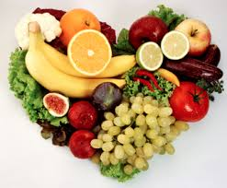
Special

Slide 22
Vegan
__________________: a person who does not eat or use any animal products
_______________________: excludes all food and products of animal origin, as well as food cooked at a temperature above 118 °F

Slide 23
Vegetarians
-Pescatarian: one whose diet includes
_____________________but no other meat
Ovo: diet allows for the consumption of _________________; no dairy products or animal flesh are allowed.
Lacto: diet includes ______________products such as milk, cheese, butter, cream, but excludes eggs and meat
Ovo-lacto: diet does not include animal flesh of any kind, but _________________ dairy and
egg products.

Slide 24
Gluten Intolerance
_______________________ Intolerant (Celiac): Intolerance to products containing gluten
an autoimmune disorder of the small intestines that occurs in genetically predisposed people of all ages from middle infancy onward.
Gluten is a protein composite found in ________________
Gluten-free food is normally seen as a diet for celiac disease, but having a gluten allergy also has similar diet needs
Grains that can be eaten: corn, potatoes, rice, tapioca, quinoa, beans, soybean, nut flours

Slide 25
Other Special Diets
Low Fat, Calorie, Cholesterol, Sodium, Sugar Diets
___________________ _________________ Diets
_____________________Diets (Fad Diets):involve making extreme, rapid changes to food consumption
_______________________ Diet: involve either not consuming or attempting to flush out substances that are considered unhelpful or harmful

