Slide 1
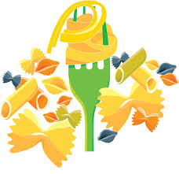
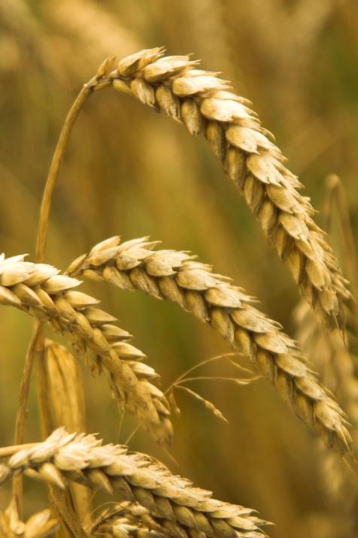
Pasta
Grains
Rice

Slide 2
History of Pasta
Popular legend has it that Marco Polo introduced pasta to Italy following his exploration of the Far East in the late 13th century
The Chinese were making a noodle-like food as early as 3000 B.C. And Greek mythology suggests that the Greek God Vulcan invented a device that made strings of dough (the first spaghetti!).
Pasta made its way to the New World through the English, who discovered it while touring Italy. Colonists brought to America the English practice of cooking noodles at least one half hour, then smothering them with cream sauce and cheese.
Thomas Jefferson is credited with bringing the first “macaroni” machine to America in 1789 when he returned home after serving as ambassador to France.
The first industrial pasta factory in America was built in Brooklyn in 1848 by, of all people, a Frenchman, who spread his spaghetti strands on the roof to dry in the sunshine

Slide 3
Pasta Facts
The average American consumes ___________lbs. of pasta annually. This makes it the 6th highest food per capita in the country.
As of March 2012, the average price an American pays for pasta is $1.45 per pound! This makes it one of the most _______________________meals.
24% of the global consumption of pasta is by Americans – the largest of any country in the world. Americans consume _______ billion pounds of pasta each year.
The United States produces 4.4 billion pounds of pasta annually, making it the second largest pasta-producing nation.

Slide 4
Convenience
You can enjoy pasta on any ____________, and thanks to its incredible versatility, you can have a different and delicious low-cost meal every day of the week.
Keeping pantry staples like dry pasta on hand is always helpful, especially for those days when the cupboard is a bit bare. No need for pricey takeout!

Slide 5
Nutrition
______________________carbohydrates like pasta
provides the optimum type of “fuel” to power your muscles and brain, as it is digested more ___________________, it provides a slower release of energy to keep you going throughout the day.
Pasta is an ideal partner for other nutritious foods that are essential to a healthy diet. It’s great to pair with fiber-filled vegetables and beans, heart healthy fish and oils, antioxidant-rich tomato sauce and protein-packed, poultry and lean meats.

Slide 6
Storing Pasta
Store _______________________, dry pasta in your cupboard for up
to one year. Keep in a cool, dry place. Follow the "first-in, first-out" rule: Use up packages you've had the longest before opening new packages.
Cooked Pasta
  Refrigerate cooked pasta in an ____________________container
  for 3 to 5 days. You may add a little oil (1-2 tsp. for each pound of cooked pasta) to help keep it from sticking. Because cooked pasta will continue to absorb flavors and oils from sauces, store cooked pasta separately from ________________.
Freezing Pasta
  The best pasta shapes for freezing are those that are used in ________________________recipes, such as: lasagna, jumbo
  shells, ziti and manicotti. You'll have better results if you prepare the recipe and freeze it before baking. To bake, thaw the dish and bake as the recipe directs.

Slide 7

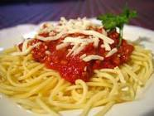
For GOOD Pasta MEASURE
Pasta is usually made from ____________________wheat
because of its high protein and gluten.
Pasta ____________________as it cooks. 1 cup uncooked
pasta will yield 2 cups cooked.
  Pasta test for doneness - _______________________(meaning firm to the tooth)

Slide 8
Basic Pasta Ingredients
_____ – made from durham wheat, calorie dense– 600 calories per cup, 7 grams of fiber, 21 grams of protein
  HIGH GLUTEN!!!
  We will use ______________________________Flour

Slide 9
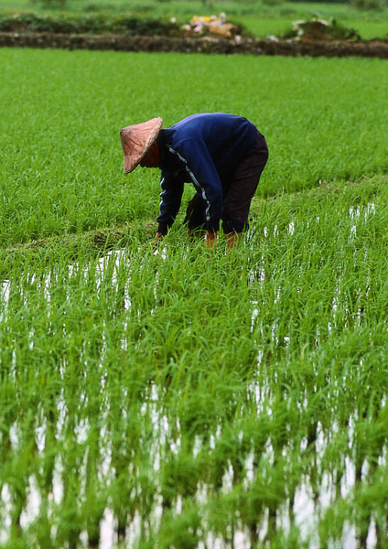
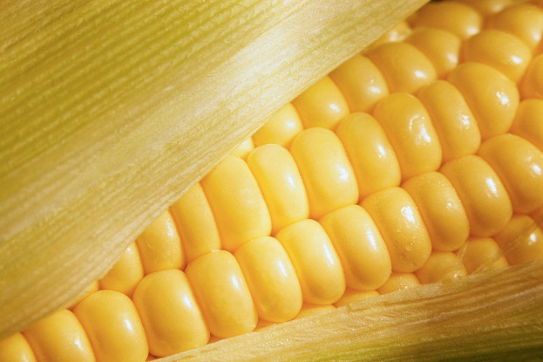
Grains
Definition: single, hard ___________
Grains are the edible seeds of
certain grasses.
Most common grains

Slide 10
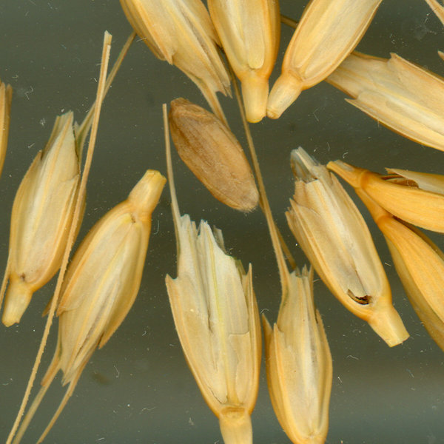
Kernel of Wheat

Slide 11
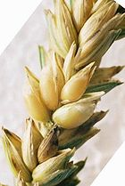
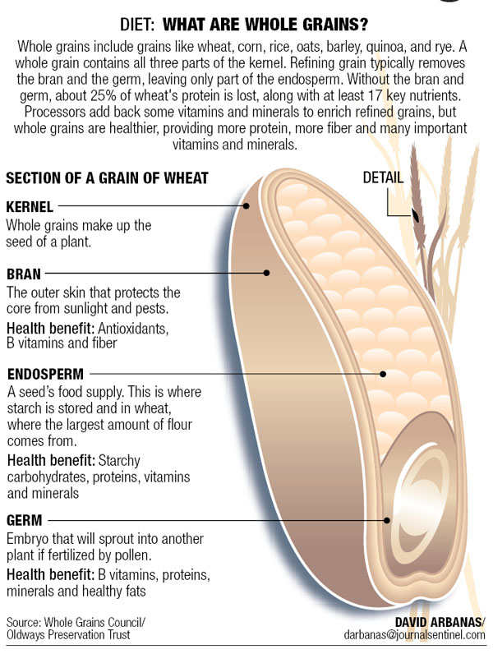
Wheat

Slide 12
Parts of the Grain
_____________- outside covering of the grain and consists of several layers.
__________________- is the inner white portion.
  complex carbohydrates, proteins, NO vitamins and minerals
___________- found at one end of the kernel, is the sprouting part from which a new part grows.
  (B vitamins, vitamin E, iron, zinc, other minerals, unsaturated fat)

Slide 13
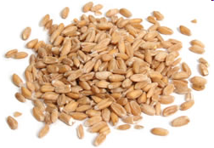
Wheat Continued…
_______________Wheat: used for flour
_________________Wheat: type of wheat with high protein and gluten contents
Wheat is known as the staff of life because of its availability around the world. It is a staple food because of its good keeping quality, high energy value and their relatively low cost.
Notes:
Semolina wheat is made to make farina cereal

Slide 14
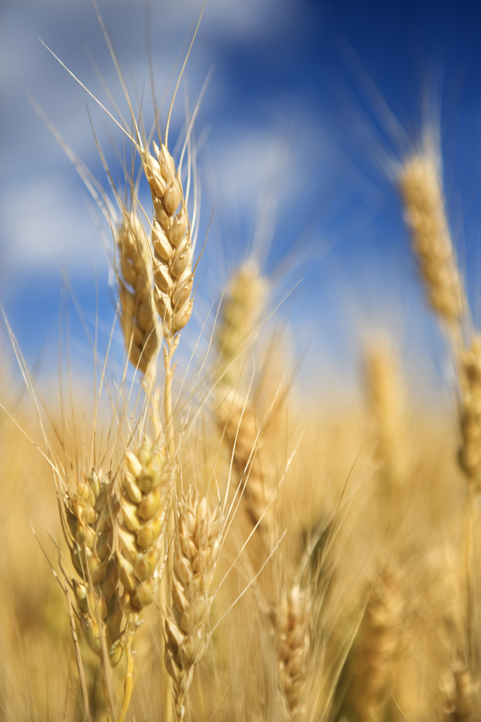
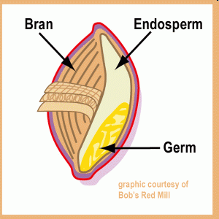
What’s a Whole Grain?
_________________Grains: Made from entire kernel including bran, germ, endosperm.
___________________grains: Milled so germ and bran are removed.
_____________________: Adding nutrients lost during the processing of the grain back into the finished product ex. White flour.

Slide 15
Why do Whole Grains Matter?
Diets rich in whole grain foods and other plant foods, and low in ___________________ fat and cholesterol, may help reduce the risk of _____________________disease
Consuming at least 3 or more ounces-equivalents of whole grains per day can reduce the risk of several __________________ diseases and may help with __________________maintenance

Slide 16
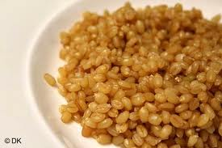
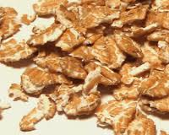
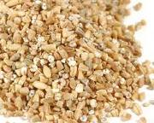
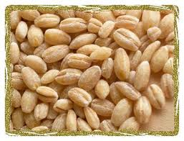
Processing Grains
Berries: whole grain minus the hull
___________: ground into fine powder
______________= Flaked: flattened between rollers
_______________: cut into small pieces to speed up cooking time
Pearled: bran removed and tumbled

Slide 17
RICE

Slide 18
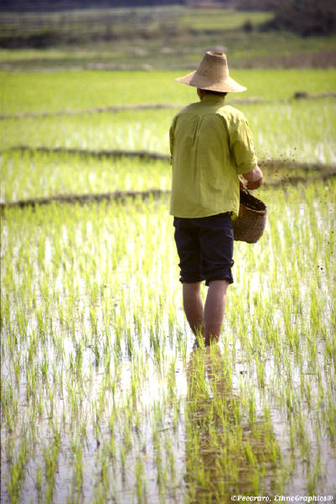
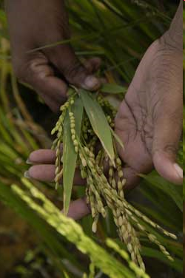
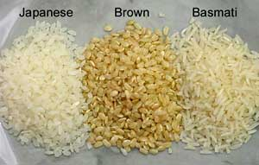
Rice
Worldwide there are more than _________________ different varieties of rice!

Slide 19
Basic Categories of Rice
______________ grain Rice- Long, polished kernels.
Bland and somewhat firm in texture. Yields a drier, fluffy rice.
  Ex. Basmati and Jasmine
______________ Grain Rice- has a shorter, wider
kernel (two to three times longer than its width) than long grain rice. Cooked grains are more moist and tender, and have a greater tendency to cling together than long grain.
  Ex. Sushi Rice
_____________ Grain Rice- Short grain rice has a short,
plump, almost round kernel. Cooked grains are soft and cling together.
  Ex. Arborio Rice

Slide 20
Cooking Rice
Double the amount of _______________for rice
(1:2 ratio)
  Bring water to boil.
  Add and stir in rice.
  Turn heat to low and put on lid.
  Cook for 20-25 minutes -- 45-1hr (brown rice).
  Rice is done if no water is visible.
  Fluff with a fork.
**Rice _______________as it cooks.
- 1 cup uncooked rice yields _______ cups of cooked rice.

