Slide 1
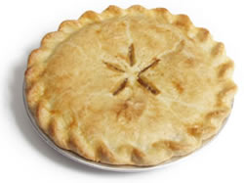
Pies and Pastries

Slide 2
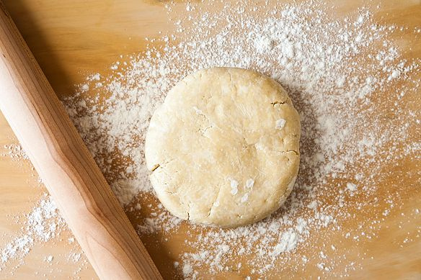
How to make a good pastry dough
Avoid __________________________________as much as possible
Disperse fat so that it will perform its
________________________ functions

Slide 3
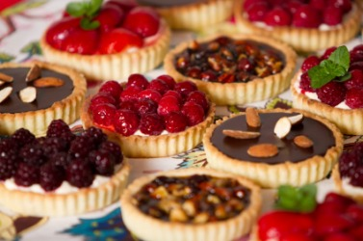
What is a pastry?
A pastry is a:
When properly mixed, the pastry forms _______________ layers as it bakes.

Slide 4
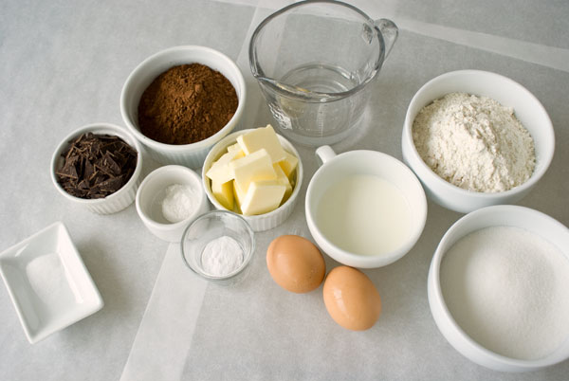
Key Ingredients &
their Functions

Slide 5
Flour
Key ingredient to make crust ________________
Provides ____________________
Gluten (protein) is an enemy to make a tender crust- it will make crust tough
Helpful in breads, so don’t use bread flour
Use a low-gluten flour
Pastry flour =tender crust, but is difficult to roll out
All-purpose flour=compromise between hard and soft wheat- generally works well.

Slide 6
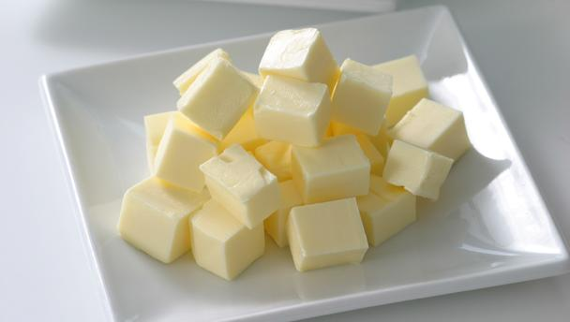
FAT
Makes pastry _________________ because it inhibits the development of gluten in the flour by forming a waterproof coating around flour
2 best fats used are: _________________________________________:
Produce more tender/flaky crust
Oil: crumbly/mealy crust
Too much fat: __________________________
Too little fat: _________________________

Slide 7
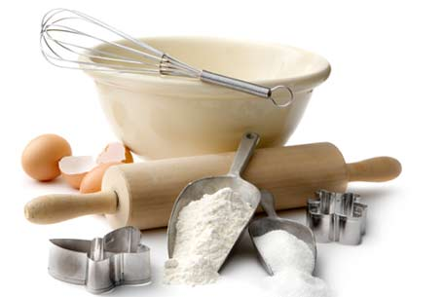
SALT - only one purpose-______________________
If a salted fat is used, the amount of salt in the recipe should be decreased.
LIQUID - ________________ is the most common liquid used in pastry
hydrate or moisten the flour so that sufficient gluten can be developed to form a cohesive dough
too much: _____________________
too little: _____________________

Slide 8
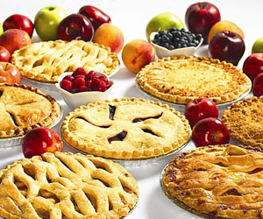
Defining Pies
A pie is a combination of a crust and a flavorful filling.

Slide 9
4 Kinds of Pies
Fruit- __________________________________
Prepared pie filling or make filling from canned, frozen, dried, or fresh fruit
Cream- __________________________________
use a cornstarch-thickened pudding mixture to make a cream filling, often have meringue topping
Custard- __________________________________
filled with custard made from milk, eggs, and sugar (may contain contain other ingredients)
Pumpkin pie is a popular custard
Chiffon pie- ___________________________________
light and airy, filled with a mixture containing gelatin and cooked beaten egg whites
Some also contain whipped cream

Slide 10
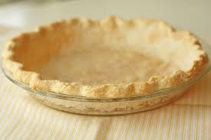
The Crust!

Slide 11
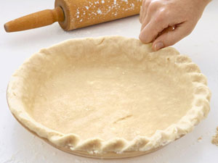
Crusts should be even, tender and nicely ____________________________.
Pastry crusts should have a delicate, ______________________________________.
Most common type of pie crust is made from _________________________.

Slide 12
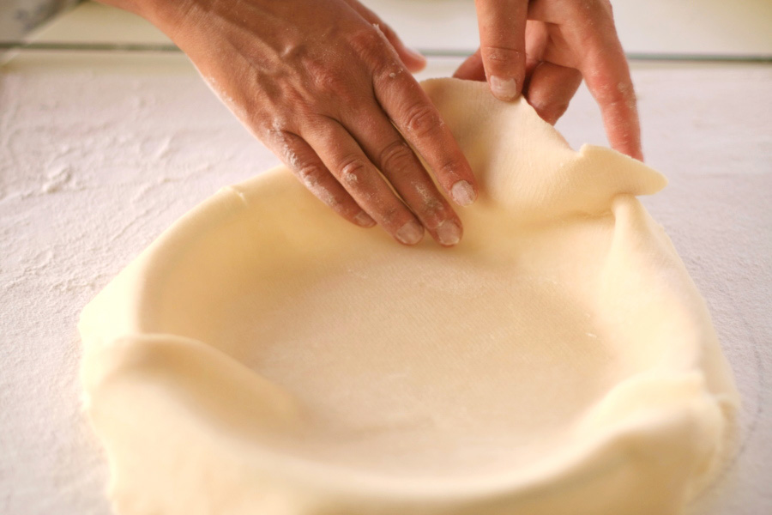
Steps to making a good pie crust

Slide 13
Flour and salt sifted together into a mixing bowl
Shortening is ____________________the flour-salt mixture with a pastry blender
resemble size of peas
3. Water must be ______________
4. Range of water amount (e.g., 4-6 Tbsp.).
practice will tell when to stop adding water
right amount allows the dough to hold together
5. Water is sprinkled a little at a time over
the flour mixture

Slide 14
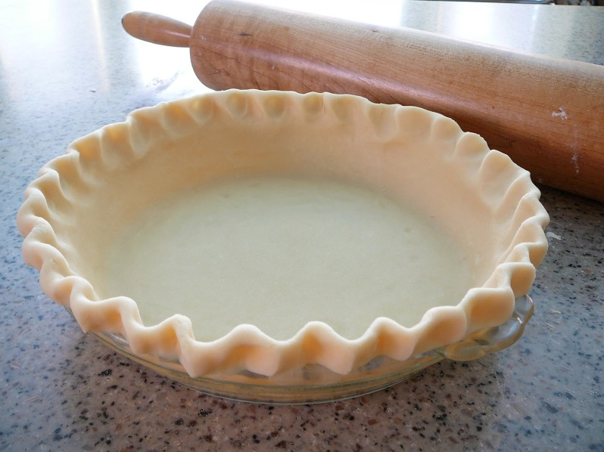
6.Gently stir dough with a fork until it forms large lumps
7. Gather dough and gently press into a ball
8. Roll out dough onto a lightly ______________surface
Re-rolling dough forms more gluten and adds toughness

Slide 15
9.Dough should be about ____________________larger
than the pie plate
10. Dough is folded into quarters and gently
placed in pie pan
11. Don’t __________________ dough while inserting it
into the pie pan
will cause the crust to shrink away from the edges while baking
12. Edges of pie crust are fluted, and bottom
and sides are pricked

Slide 16
Definition: Fluting is the
________________: For a simple and attractive seal, press the rim of the crust together all around the edges with the back of the fork tines.
_________________: Do not cut around the edges right away; after pinching the crust up using your index and fore finger, cut the excess pastry.
________________: Roll the pastry under or over creating a sealed edge to the pan.

Slide 17
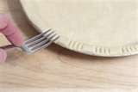
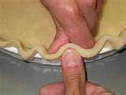
Decorative edges
Fork Fluted

Slide 18
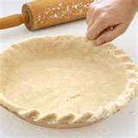
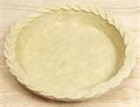
Decorative edges
Rope Braided

Slide 19
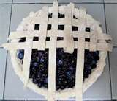
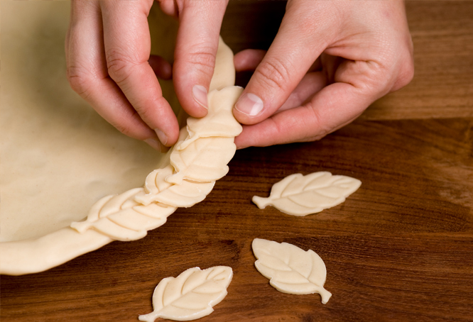
Decorative edges
Lattice topping Cut out

Slide 20
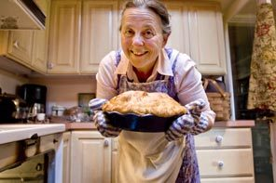
Baking Tips!
For a well-browned crust, select heat resistant pans, with a dull finish.
To prevent excessive browning of pastry, cover ______________ with foil. Remove foil the last 15 mins of baking time.
Do not prick the bottom of a ____________________ pie baked with a filling such as custard of pumpkin.
Cut slits in the ____________ of a fruit piecrust to allow steam to escape.

