Slide 1
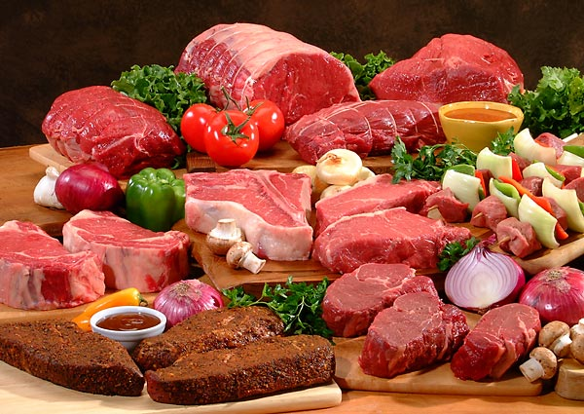
Meat

Slide 2
What is Meat?
Meat is
In the U.S., the major meat-producing animals are cattle, swine and sheep.
You need _________ servings from the meat group per day.
Each serving is a total of _____________.

Slide 3
Nutritional Value of Meat
Meats are good sources of:
The amount of _______ meat contributes to the diet depends on the ________ of the meat.

Slide 4
Where’s the Beef!?
Beef comes from mature cattle over __________________________________________
Beef is usually bright, _________________in color with creamy white fat.
They are classified according to ________ and _________

Slide 5
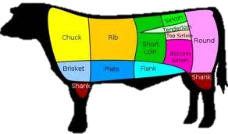
Beef
It’s the ___________________animal used for food.
_______________________cuts are the sides cut into quarters and then into smaller pieces.
____________________cuts are wholesale cuts still cut into smaller pieces at the grocery store.

Slide 6
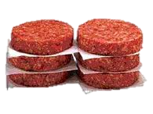
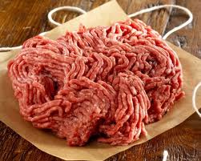
Ground beef
Ground beef - contains only the ________________________attached to the meat before grinding.
Hamburger - can have ___________added to it during grinding.

Slide 7
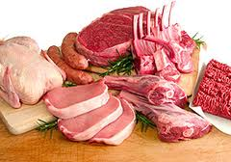
Other Meats
Veal - a very young beef. Cattle less than ____ months of age.
Pork - meat of a swine. Swine that are _______ months old.
Lamb - meat of sheep. Sheep less than ___________old. Small animal used for meat.
Variety Meats - the edible parts of the animal other than the muscles. EX) liver, heart, kidney, tongue, and sweetbreads.

Slide 8
Inspection and Grading
Federal inspectors must examine _____________________________________ shipped across state lines.
The _________ overseas the grading program.
Graded based on ________________, maturity, texture and ____________________.

Slide 9
The USDA shield assures consumers meat has met certain standards of quality
USDA___________
USDA __________
USDA ___________

Slide 10
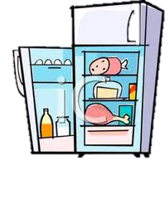
Storing Meat
Freezer Storage:
Type of Meat
Luncheon meat
Ham
Ground meats
Pork cuts
Lamb
Beef
Refrigerator Storage:
Type of Meat
Fresh meat cuts
Ground meats
Variety meats
Leftover cooked meats

Slide 11
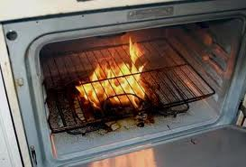
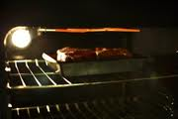
Cooking Meat
Using too _____________of a cooking ______________can result in cooking losses.
Fat, water and other unstable substances that evaporate from the surface of the meat.
Causes meat to ___________________, and decrease in size and weight.

Slide 12
Beef Cookery Methods
________________
Cooking in Fat
Deep Fat Frying
Pan Frying
____________________Methods
Tender Cuts
Roasting
Broiling
Pan-broiling
Stir-Frying
_____________________________Methods
Less Tender Cuts
Braising - brown in small amounts of oil, add liquid and cover. Simmer unitl tender.
Cooking in Liquid
Boiling
Steaming
Simmering

