Slide 1
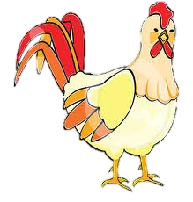
Fish and Poultry

Slide 2
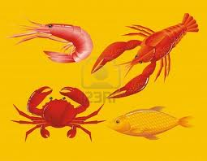
Fish and Shellfish

Slide 3
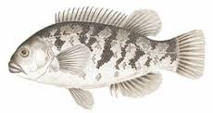
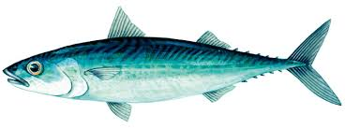
Two Types of water animals:
Finfish:
They can be _______________or ______________.
Lean fish have very little fat b/c their flesh is white (aka white fish).
Fatty fish have fatter flesh b/c their flesh is pink, yellow or gray (ex. Catfish, salmon, and mackerel).

Slide 4
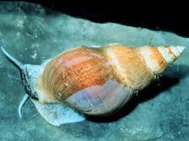
Two Types of water animals:
Shellfish:
They can be __________________or ___________________.
Mollusks soft bodies and their shell covers their body fully (ex. Oysters, clams and scallops).
Crustaceans two segmented bodies and their shells are firm (ex. Shrimp, lobsters, and crabs).

Slide 5
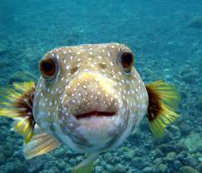
Nutritional Values
They are in the meat and bean group.
Need__________oz per day → (not necessarily just of fish– just in the food group!)
______________________ protein.
Slightly higher in minerals than raw meat.

Slide 6
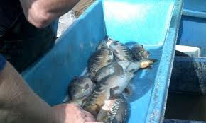
Inspection and Grading
The National Marine Fisherman Service provides a voluntary inspection program for the fish industry.
Fish that has been inspected has a _________on it.
A grade seal is on fish that have been graded.
Most graded are “U.S. Grade ____________.”
There are Grade A, B, and substandard

Slide 7
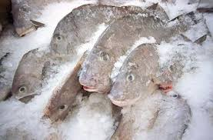
Storing Fish and Shellfish
VERY ____________________________!
Wrap fish tightly in wax paper or foil.
Place it in a tightly covered container in the ___________________________ part of the refrigerator.
Use stored fish within one or two days.
For freezer storage, wrap fish in moisture proof material; store in coldest part of freezer.
For __________________ storage, place in a cool, dry place

Slide 8
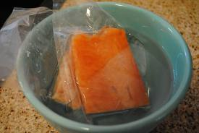
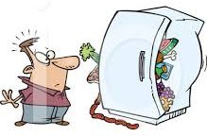
Cooking Fish and Shellfish
To Avoid Foodborne illness:
Wash hands thoroughly before and after handling.
DO NOT THAW FROZEN PRODUCTS AT _________________ TEMP.
________________ everything that touched the raw fish.
Use a internal temperature of cooked seafood that has reached ___________ °F.
Refrigerate leftovers promptly.

Slide 9
Methods of Cooking
Broiling
Baking
Poaching
Microwaving
Steaming
For Shellfish: cook them for a ______________time at moderate temperatures.
Over cooking causes the proteins to tighten making it _________________.

Slide 10
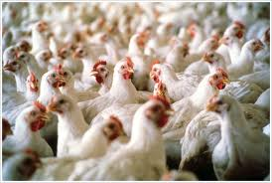
Poultry

Slide 11
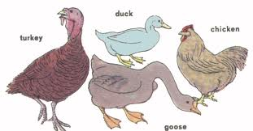
Defining Poultry
Poultry: describes any domesticated _______________.
Ex- chicken, turkey, goose, and duck are most commonly eaten in the U.S.

Slide 12
Inspection and Grading of Poultry
All poultry sold in interstate commerce must be ______________________ inspected for wholesomeness.
You will find a round seal on the tag attached to the wing of approved birds.
Most poultry sold is graded “U.S. Grade ____.”
Grade B and C are usually processed products.

Slide 13
What to buy…
Most birds are sold _________________; they are more tender.
Chickens can be purchased _______________, cut into halves or cut into ______________.
Turkeys and Chickens have both ____________and dark meat.
Ducks and Geese have all dark meat. They also have more ______________than turkeys and chickens.

Slide 14
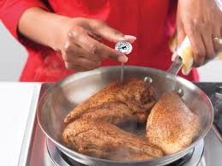
Cooking Poultry
Poultry is a __________________.
Use __________
temperatures and careful timing.
Overcooking, causes it to be tough, dry an flavorless.

Slide 15
Methods of Cooking Poultry
Microwaving
Frozen Poultry- thaw before cooking.
De-boning Poultry- taking the ____________out.
Roasting
Broiling
Grilling
Frying
Over-frying
Braising
Stewing

Slide 16
Storing Poultry
All poultry, except canned, is VERY ______________________________!!!
Proper storage is also important to inhibit the growth of salmonella, and illness causing bacteria often found in poultry.
For refrigerator storage, rewrap the bird loosely in waxed paper.

Slide 17
In Conclusion…
Fish and Poultry are part of the meat group.
They are highly perishable.
They should be carefully cooked and handled in order to prevent foodborne illness.
When bought in the store, they are usually graded “U.S. Grade A.”

