Slide 1
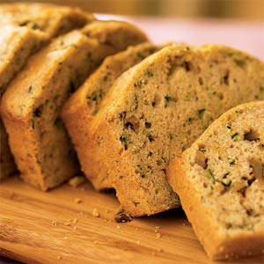
Quick Breads

Slide 2
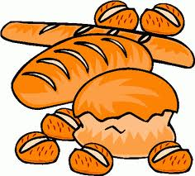
What is a quick bread??
Quick breads are quick and easy to make. Most don’t ____________________________________and usually use __________________________as a leavening agent.
**Quick bread is any bread leavened with ______________________ _______________other than yeast
They are…
High in ____________________________, protein, B vitamins and ____________.
Some quick breads can be ____________________________.
Examples of quick breads are:

Slide 3
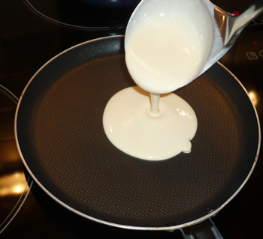
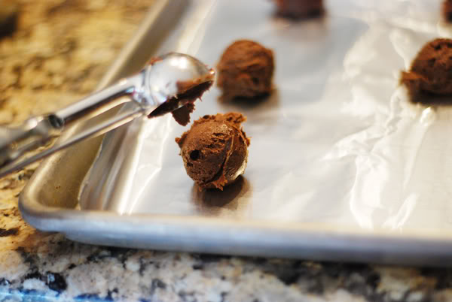
Types of Quick Breads
________________________________ such as pancake batter, have a liquid to dry ratio of about 1:1 and so pours in a steady stream.
___________________________such as cornbread and muffin batters, have a liquid to dry ratio of about 1:2.

Slide 4
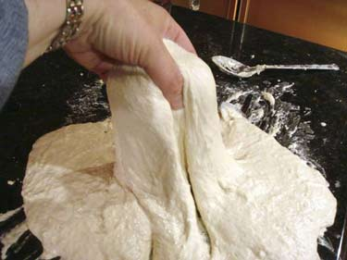
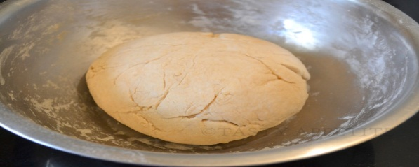
Types of Quick Breads
_________________________such as many chocolate chip cookie doughs, have a liquid to dry ratio of about 1:3. Soft doughs stick significantly to work surfaces.
_________________________such as pie crust and sugar cookie doughs, have a liquid to dry ratio of about 1:8. Stiff doughs are easy to work in that they will only minimally stick to work surfaces, including tools and hands.
Kneading: Pressing the dough with the ______________ of your hands, ______________and ________________. Repeat this motion until the dough is ________________ and elastic.
**Too much kneading =

Slide 5
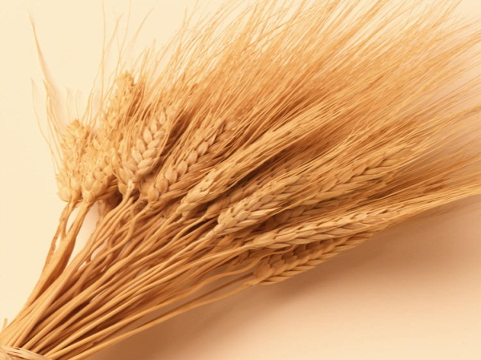
Gluten gives elasticity to dough, helping it ____________ and keep its shape and often gives the final product a ____________texture.

Slide 6
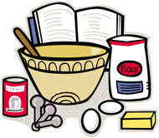
Common ingredients in all baking:
_________________-proteins and starch in flour gives most
of the structure
__________________________ Usually water or milk
(strengthens product when mixed with flour)
________________________ agents- causes product to rise
__________________adds tenderness, richness and flavor
__________________-provides sweetness and flavor, makes
product tender, and helps crust brown
_______________help form the structure and binds
_________________- extract flavors, spices, herb, vegetables,
nuts

Slide 7
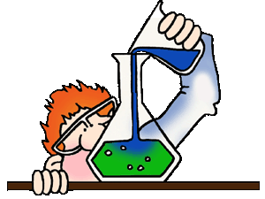
Leavening agents
Leavening agent is:
Types of leavening agents:
_____________: trapped air in mixture expands when the product is heated. Ex: Angel food is mainly leavened by the beaten egg whites
______________: As a product bakes, the temperature of the water rises and steam is formed. The steam expands which causes product to rise. Ex: Cream puffs

Slide 8
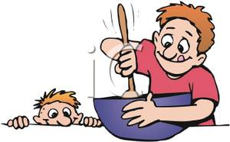
____________________: is a living microorganism that produces carbon dioxide gas as it grows. Yeast requires food, liquid and warm temperatures in order to act as a leavening agent
__________________________: leavening agent used with acidic liquids, such as buttermilk, yogurt or sour milk. Baking soda produces carbon dioxide gas when activated by the acidic liquid
___________________________: Made of baking soda and a powered acid (ex: cream of tarter). Reacts 2x.

Slide 9
The Muffin Method
3 Steps:
1. Mix all
2. Mix all
3.
Tips:
Do _____________________________mix!!
Mixture should be ___________________
A properly mixed muffin should have a _________________________, pebbly top

Slide 10
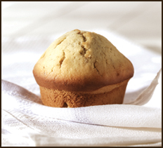
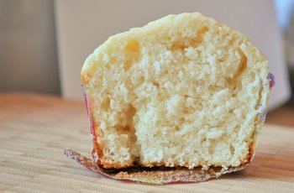
What happens when you OVER-mix??

Slide 11
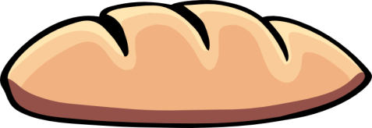
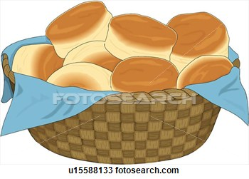
Loaf Breads
Many quick loaf breads are mixed in the same manner as muffins.
Usually baked in greased loaf pans
If bread contains fruits or nuts, the bottom of the pan should be lined with parchment paper
Biscuits
Biscuits are delicate, crisp crust and peels apart in tender layers
2 kinds of biscuits:
________________________-rolling out dough ½ inch thick and cutting with a biscuit cutter. If you do not have a biscuit cutter, use the rim of a water glass.
____________________________- dough is dropped with spoon. Contain more liquid and are too sticky to roll.
- Both are made using the pastry and biscuit method of mixing

Slide 12
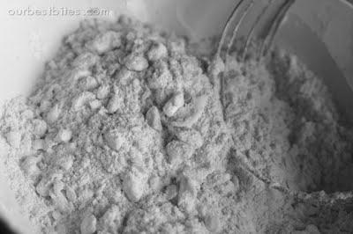
Pastry and Biscuit Methods
In the pastry and biscuit method the fat is ______________________the flour.
To cut in means to:
If you are doing this correctly, your mixture should appear ‘pebbled’ or look like oatmeal

Slide 13
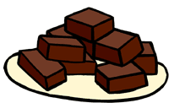
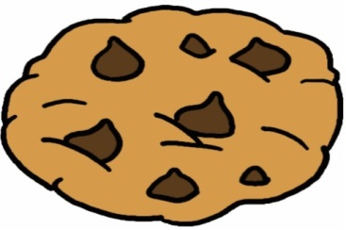
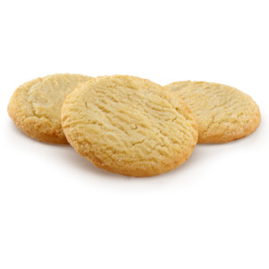
Cookies
Cookies vary in texture, shapes, and sizes. There are ______ basic kinds of cookies:
_______________________________: Are baked in square or rectangular pans and then cut into bars, squares or diamonds. Textures vary from cakelike to chewy.
Ex: ______________________________
2. _______________________________: Made from soft dough that is dropped from teaspoon onto cookie sheet.
Ex: ____________________________________
3. ________________________________: Also called cut-out cookie. Are made from stiff dough that is rolled out and cut out.
Ex: __________________________________

Slide 14
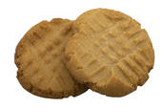
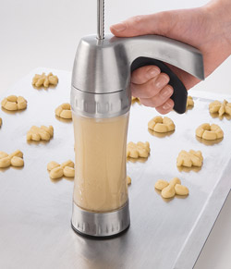
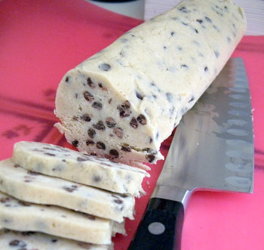
4. ______________________________: Are formed by shaping the dough by hand into balls. Can be rolled in nuts or can be flatten with a fork before baking.
Ex: _____________________________________________
5. ______________________________________: Are made by pushing dough through a cookie press, which can create a variety of shapes.
Ex: __________________________________
4
6. ________________________________: Also called refrigerator cookies. They are made by forming a soft dough into a long roll and refrigerating it. When roll is chilled and firm, cookies are sliced and baked

