Slide 1
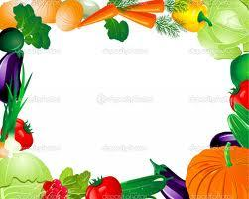
All About Vegetables!

Slide 2
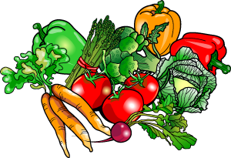
Defining Vegetables
Vegetables are:
Hundreds of different kinds can be prepared in many different ways.
You need ______ servings from the Vegetable Group each day.

Slide 3
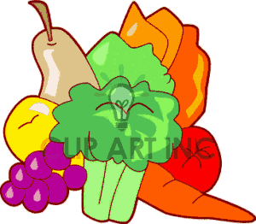
Forms of Vegetables
Fresh veggies have the most ____________________.

Slide 4
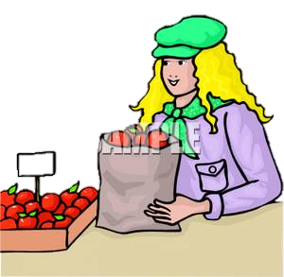
Buying Vegetables
Signs of freshness:
____________-should feel heavy in relation to its size.
_______________- not too pale or too dark.
__________________________- no decay, soft spots or damage.
__________ vegetables are sold loose or in packages.

Slide 5
Buying for the Season
____________- squash, cauliflower, garlic, ginger, mushroom, pumpkin, sweet potatoes
______________- kale, leeks, radishes, rutabaga and turnips
_____________- artichokes, asparagus, carrots, chives, fava beans, fennel, mustard greens, potatoes, spinach, lettuce, sugar snap peas,and onions.
___________________-beets, broccoli, cabbage, corn, cucumber, eggplant, green beans, squash, tomatoes and zucchini

Slide 6
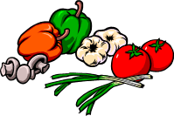
Storing
Most vegetables should ________________________as soon as you bring them home.
If they’re wet, shake off the excess water. Too much moisture _________________________________________________.
Don’t wash them until you are ready to prepare or eat
_______________ and ______________ should be stored separately in a _________________________________________________.

Slide 7
______________________________are available to buy packaged individually or mixed.
______________________________are available whole, sliced, or in pieces.
__________________________ Only need to be reheated according to directions.

Slide 8
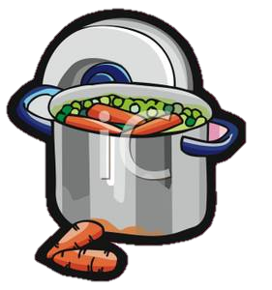
Preparing Raw Vegetables
Wash them to remove
_________________________________________________
Using ____________ water, and sometimes a brush.
Cut ___________________________and parts that can’t be eaten.

Slide 9
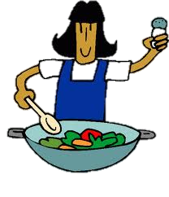
Cooking Vegetables
Cooking makes them easier to _____________________________________________.
____________________________________________
Stay ________________ in color
Are tender and crisp
Have a mild, mellow flavor.

Slide 10
__________________________ One of the most healthy ways to cook, because fewer nutrients are lost since vegetable is not in water
-Vegetable is cooked over, not in, water to help prevent nutrient loss
about ½ cup of water in saucepan, cover and bring to a boil. Add veggies, cover and simmer until tender
-Do not use aluminum or copper pans (minerals react with sulfur compounds in veggies, resulting in loss of vitamin C, E and Folic Acid)

Slide 11
Cooks food quickly, using only a small amount of water. Keeps nutrients, color, texture and flavor.
-pierce skinned vegetables with a fork, to avoid vegetable from bursting
-Always cover containers to keep in moisture
- Vegetables with a high moisture content bake in an oven.
Winter squash, potatoes and sweet potatoes
Pared whole vegetables such as carrots, onions, and potatoes can be baked in the same pan as a roast, but adds fat

Slide 12
Most vegetables are capable of being sautéed, stir fried, and deep fried.
sometimes done before a recipe to bring out the flavor
- Both of these methods are used with oil, which adds fat and calories to the vegetables. Especially with deep fried vegetables.

Slide 13
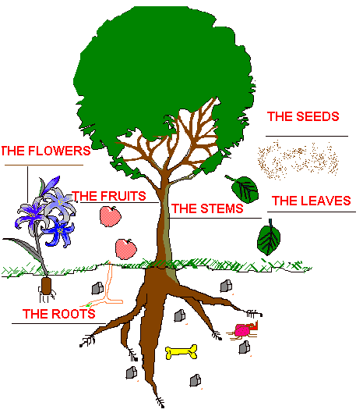
Parts of the Plant

Slide 14
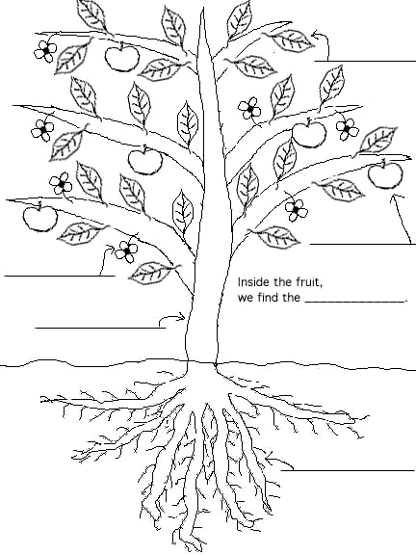

Slide 15
What Part Of The Plant Do You Eat???

Slide 16
Roots
Two categories
* ________________- onions, radishes and garlic
*_______________- carrots and potatoes
High in ____________ and calories.
Ex: Onions, Carrots, Potatoes, Radishes, Garlic, Turnips, and Beets
They are the pathways for water to travel from the soil to the plant; _____________________________________.
They also:

Slide 17
Stems
They _____________ the plant.
Slender stalks are more tender.
They are high in _______________ and low in ________________
Ex:

Slide 18
Leaves
They capture the sunlight to make the _______________ for the plant (____________________)
The ______________ the leaves the _______________ the nutrient content.
They are _________ in water and ________ in calories.
Ex: Spinach, Lettuce, Cabbage, Brussel Sprouts, and Sprouts.

Slide 19
Flowers
These are the _______________________________________.
They are high in __________ and low in _______________.
Ex:

Slide 20
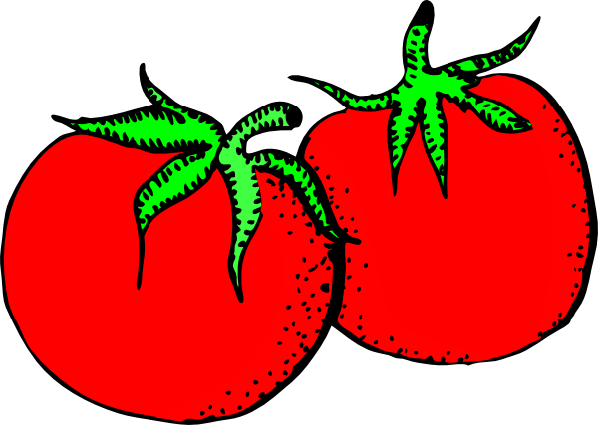
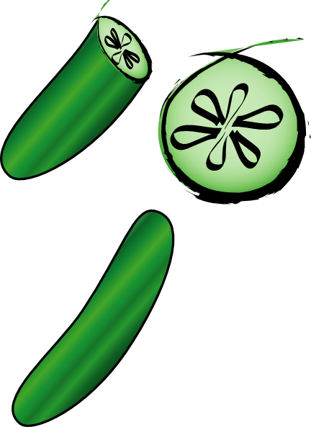
Fruit
They are high in water and low in calories.
Ex: Tomatoes, Cucumbers, Eggplant, Bell Peppers, Other Peppers, Pumpkin, Squash, and Green Beans
They contain the _____________ of the plant.
They are not _____________like the foods we call fruit.

Slide 21
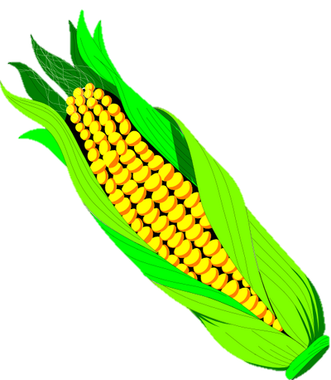
Seeds
They _____________________so that other plants can be ______________.
They are high in starch and high in calories.
Ex:

