Slide 1

Types of Fruit!

Slide 2
4 Different Forms of Fruit Available

Slide 3
Fresh Fruits
Raw Fresh Fruit
  Fresh fruit contain more nutrients than cooked fruit.

Slide 4
Enzymatic Browning
Discoloration results from exposure of a fruit’s _________________ to the air
  Prevention:
    Coat fruits with __________________________________________________________________________________________
      Lemon, lime, grapefruit, or orange juice

Slide 5

Fresh Fruits
Cooked Fresh Fruit
  More _________________
  (pleasant to taste)
  Cooking will preserve ________________ fruit.
  Good source of vitamins and _____________
  Overcooking causes loss of:

Slide 6

Canned Fruits
Canned fruits may be purchased in the following forms:
    * Whole * Tidbits
    * H * S
    * Sliced * Juice
    * Chunked * Sauce
    * C * S

Slide 7
Canned Fruits
__________________ or _______________pieces of canned fruit usually costs more.
Store cans in a __________________________________.
Rotate the stock of cans and avoid keeping canned fruit for longer than _________________months.

Slide 8

Canned Fruits/Juices
Canned fruits come packed in __________________or in light, heavy, or extra heavy ___________________.
Juices come in bottles, cartons, cans, or frozen concentrate
If label says “juice” the product =_____________%juice
  If not pure juice must be called another name “fruit drink”

Slide 9
Fruit Sauces
Goal=break down _______________
_________________isn’t added until end of cooking
  This thins sauce
When cooking in water use as __________________water as possible
  Prevents loss of flavor and water soluble nutrients

Slide 10

Frozen Fruit
Fruits may be frozen ___________ or _____________ and may be packed with or without _____________.
It is recommended the fruits be kept frozen at ______ or lower for no longer than ___________________________
If fruits become defrosted, it is recommended ________________________________. Use defrosted fruits as soon as possible.

Slide 11
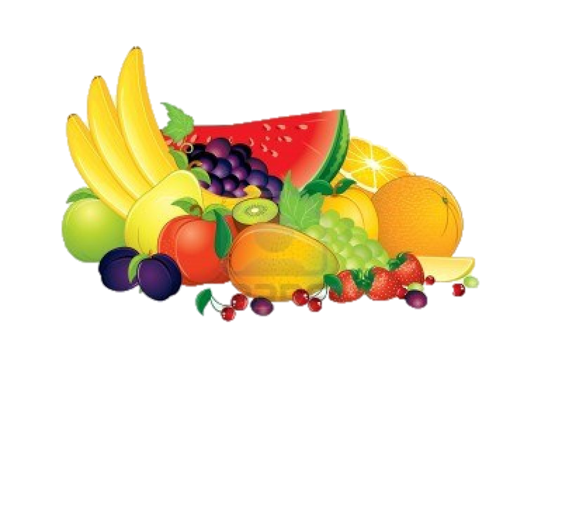
Dried Fruits
Dried fruits are nutritious, keep well, and have a sweet fruity flavor.
Some fruits such as plums (prunes) are put into dehydrator tunnels for 15-24 hours, unlike other such as grapes (raisins) are air dried for 2-3 weeks.

Slide 12
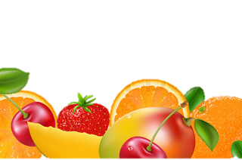
Dried Fruits
Fruits which are dried include:
  A
  A
  D
  Figs
  Peaches
  Plums
  Grapes
Uses of dried fruits:
  Main dishes
  Chewy snack
  Pastries

Slide 13
Storing Fruits
Most fruits are stored in the crisper drawer in the _______________________
  Citrus and pomes last longer than berries and melons
To speed up the ______________________process, store fruits at room temperature in a brown paper bag

Slide 14
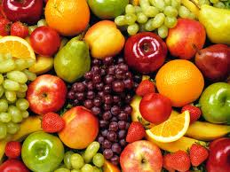
Fruit
Classifications

Slide 15
Pomes
Characterized by a smooth skin covering an enlarged __________________area surrounding the ___________________(seeds).
Examples:
-
-pears
-applepear

Slide 16
Drupes
Contain a single seed, or the _________________, surrounded by a ___________________, juicy, edible portion.
Examples:
-
-Nectarines
-Apricots
-
-Plums

Slide 17
Berries
Berries have tiny _______________embedded in the flesh and a fragile cell structure.
Examples:
-
-Cranberries
-
-Grapes

Slide 18
Citrus Fruits
Citrus fruits have a ____________________ outer rind and a thin membrane that separates the flesh of the fruit into ____________________.
Good source of vitamin C
Examples:
Grapefruit,_________________, tangerine, tangelo, kumquat, _________________, lime, mandarin orange, ugli fruit

Slide 19
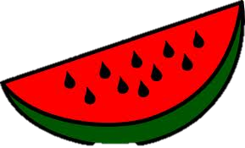
Melons
Melons are large, juicy fruits with a _________________skin and many ______________.
Examples:
-
-Cantaloupe
-
-Casaba
-Muskmelon

Slide 20

Tropical Fruits
Tropical fruits are grown in ________________climates and are considered to be somewhat exotic.
Examples:
Plantain
Mango
Papaya
Pomegranate
Pineapple
Kiwi

Slide 21
Which fruits ripen?
Won’t ripen after harvest
Apples
Berries
Grapefruit
Oranges
Pineapples
Tangerines
Will ripen after harvest
Apricots
Avocados
Bananas
Kiwi
Mangoes
Nectarines
Peaches
Pears

